Slide 1
Deep-Q Network

Slide 2
Objectives
NFQ Challenges
Target Network
Experience Replay
Better exploration strategies
Deep Q-network (DQN)
Comparison

Slide 3
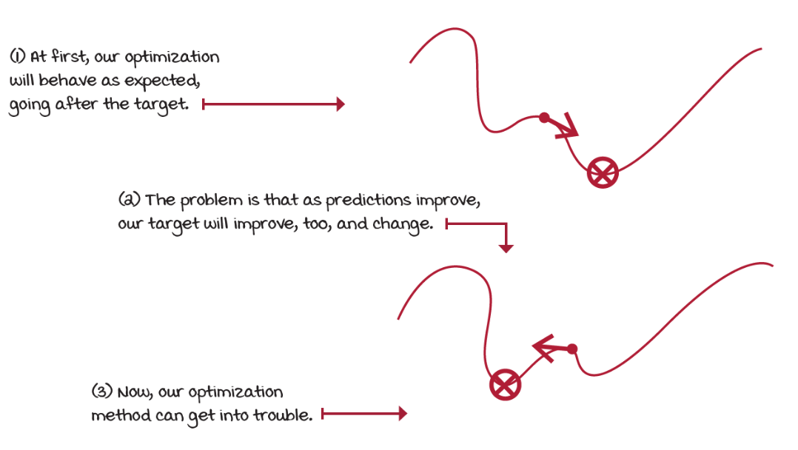
NFQ Challenges (1)
Notice that we’re using a non-stationary target for the learning updates
as we update the weights of the approximate Q-function, the targets also move and make our most recent update outdated.
Training becomes unstable quickly

Slide 4
NFQ Challenges (2)
We batched K experience samples, collected online, and update the NN from that mini-batch
these samples are correlated, they come from the same trajectory and policy
later we use different mini-batches that are also internally correlated, but likely different from previous mini-batches
This means that we aren’t holding the IID assumption,
optimization methods assume data samples independent and identically distributed
We’re training on almost the exact opposite
samples are not independent
the outcome of a new state is dependent on current state
samples aren’t identically distributed
underlying data generating process, the policy, is changing over time
optimization methods allow to relax the IID assumption to a certain degree, but we go all the way

Slide 5
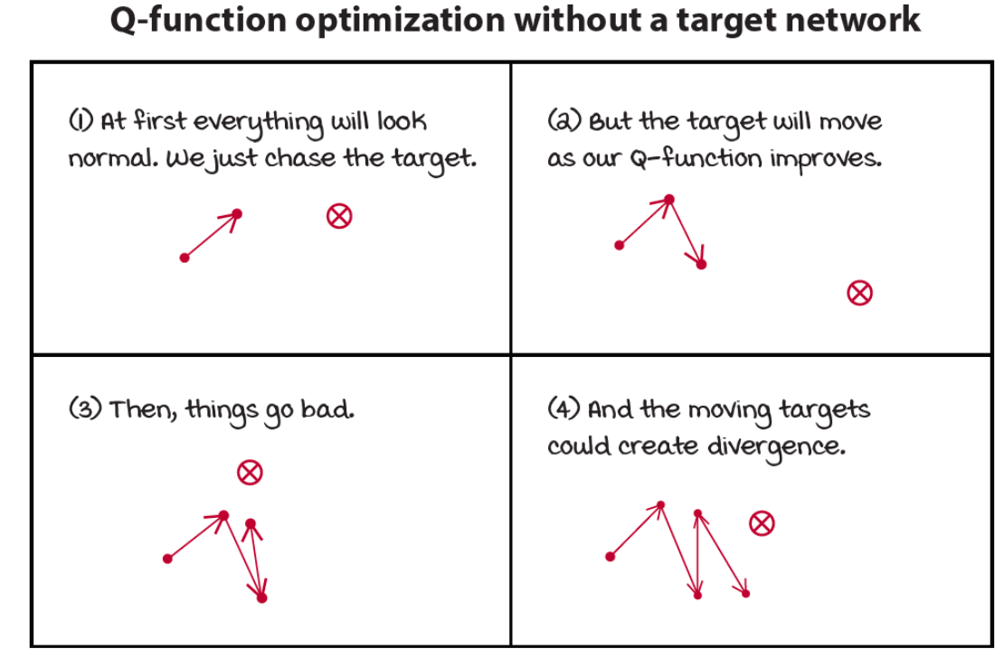
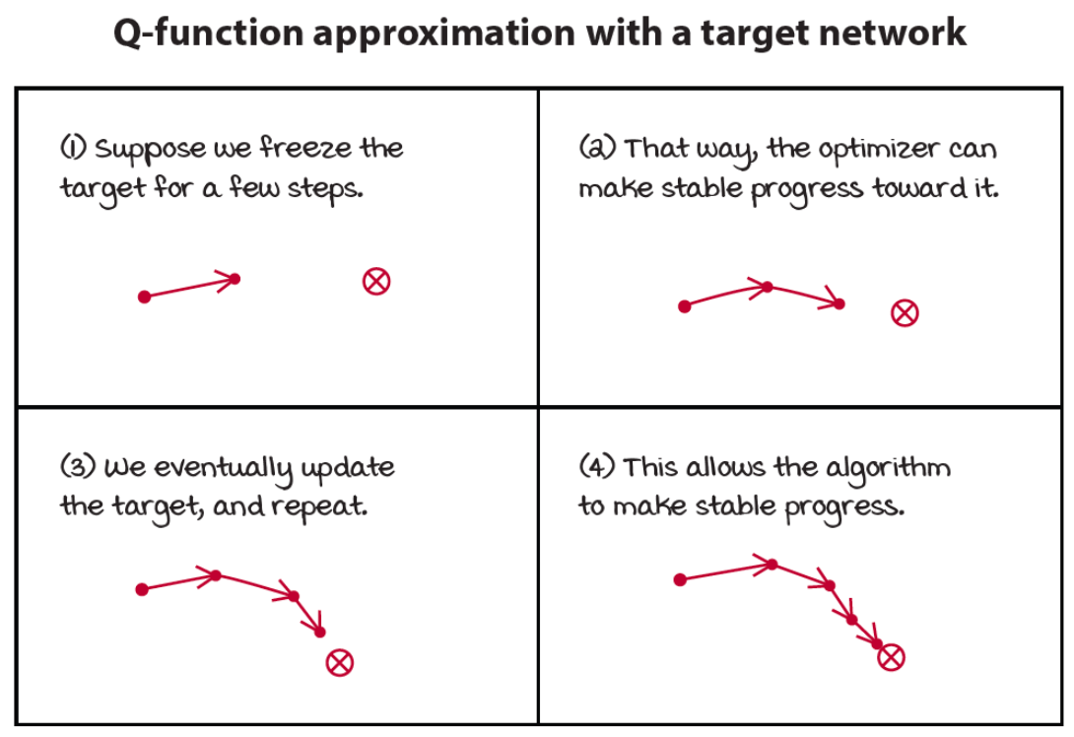
Target Network (1)
A way to make target values more stationary is to have a separate target network
We can fix it for multiple steps and reserve it for calculating more stationary targets

Slide 6
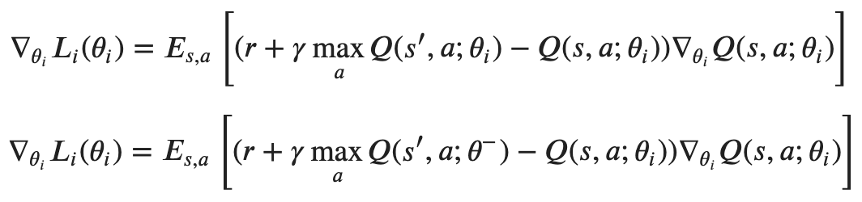
Target Network (2)
We create several small supervised learning problems presented sequentially to the agent
targets are fixed for as many steps as we fix our target network
substantially reduces the chance of divergenge
The only difference with NFQ is the age of the neural network weights
notice that we don’t have two different networks
target network is a previous instance of the network that we freeze
It’s essential to balance stability and speed by tuning this hyperparameter
the gradient update has time to catch up to the target: which is stable
we slow down learning because you’re no longer training on up-to-date values

Slide 7
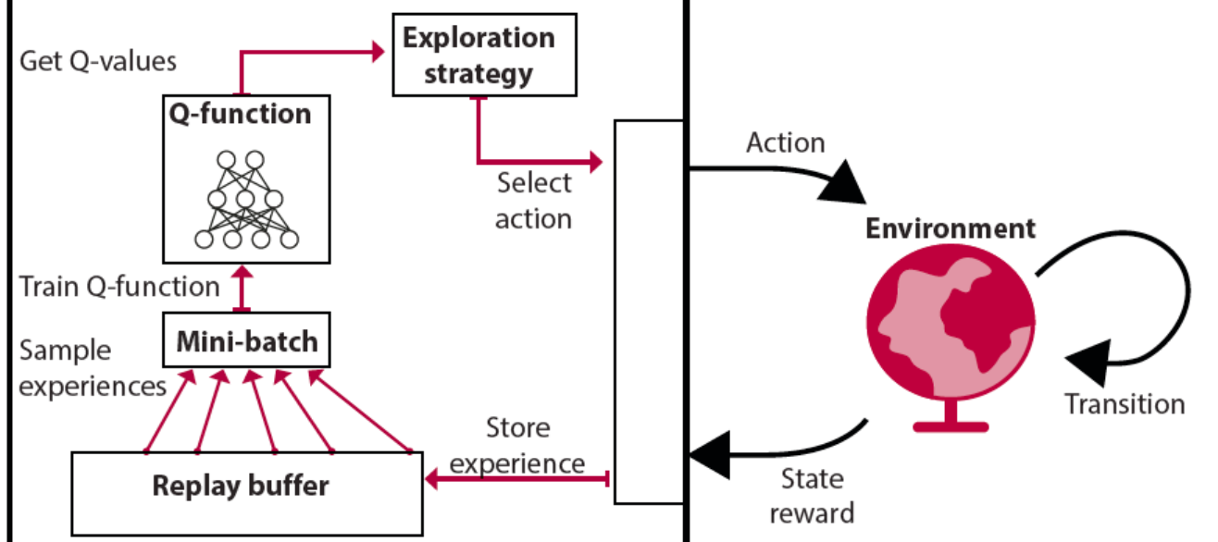
Experience Replay (1)
A data structure D to hold experience samples e_{𝑡}=(𝑆_{𝑡},𝐴_{𝑡},𝑅_{𝑡+1},𝑆_{𝑡+1}) for several steps
D=e₁,e₂,...,e_{𝑀} , 𝑀: size of the replay memory
If 𝑁<<𝑀, sampling of mini-batches comes from a broad set of past experiences
training can use more diverse mini-batch for performing updates
gives the impression data are IID (sampling from multiple trajectories)
agent no longer has to fit the model to the same mini-batch for multiple iterations

Slide 8
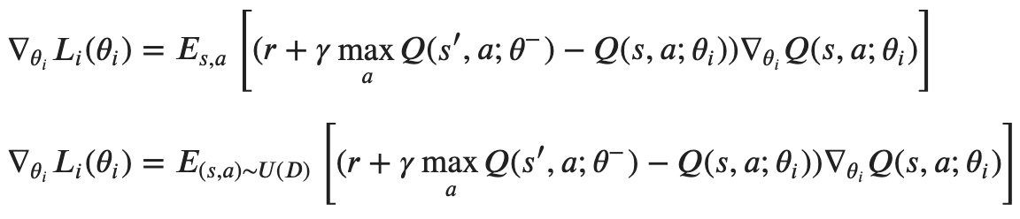
Experience Replay (2)
A sufficiently large replay memory yields a slow-moving target
lower risk of divergence
Unfortunately, implementation Is a challenge with high-dimensional observations
replay buffers hit a hardware memory limit quickly
e.g. image-based environments (each state representation is a stack of the latest image frames)
The difference with previous equation is that we’re now obtaining experiences by sampling D, instead of using the online experiences

Slide 9
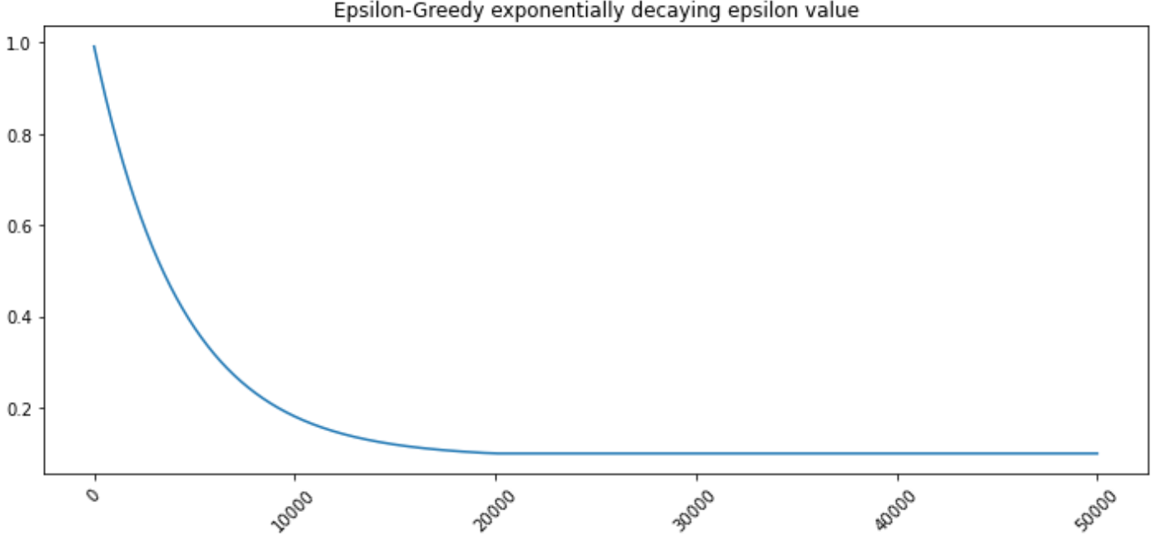
Better exploration strategies
Exploration is a vital component of RL
in NFQ, we use an epsilon-greedy exploration strategy
acting randomly with epsilon probability
However, this is not the only possible strategies to balance exploration and exploitation
exponentially decaying epsilon-greedy exploration strategy

Slide 10
Deep Q-network (DQN) (1)
One of the most popular deep RL algorithms and it started a series of research innovations that mark the history of RL
DQN claimed for the first time superhuman level performance on the Atari benchmark in which agents learned from raw pixel data from mere images
V. Mnih, et al. "Playing Atari with Deep Reinforcement Learning", NIPS 2013
The main difference with NFQ are
use an exponentially decaying epsilon-greedy strategy
use a replay buffer
use a target network
The algorithm has three main steps:
collect experience and insert it into the replay memory
randomly sample a mini-batch from the replay memory, and calculate the off-policy TD targets for the whole batch
fit the action-value function Q(s,a; θ) using MSE and RMSprop

Slide 11
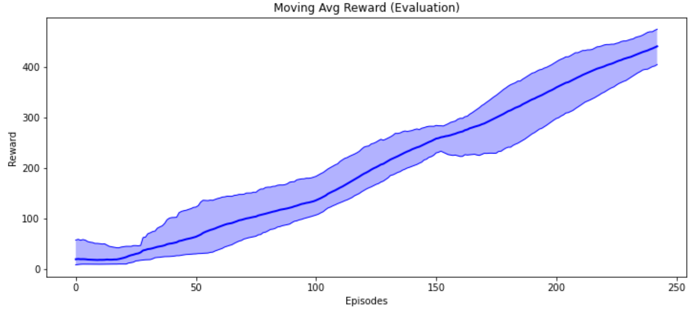
Deep Q-network (DQN) (2)
See “deep-q-network.ipynb”

Slide 12
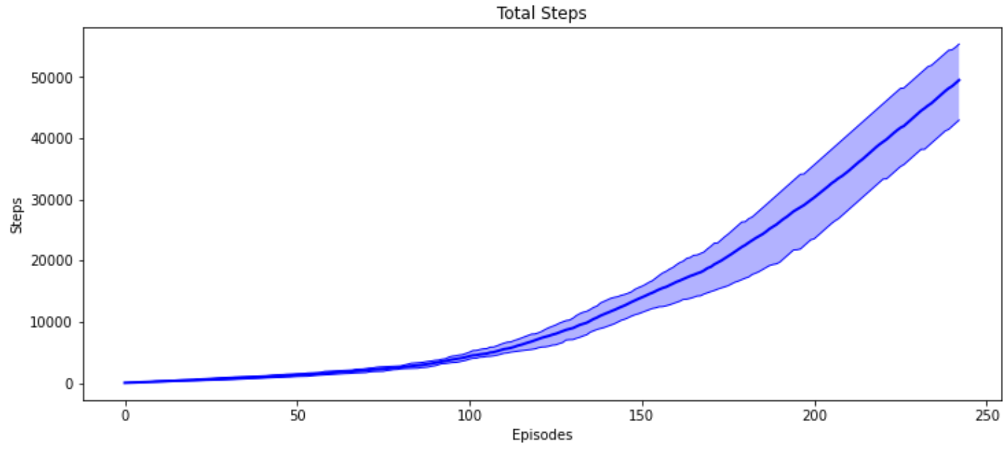
Deep Q-network (DQN) (3)

Slide 13
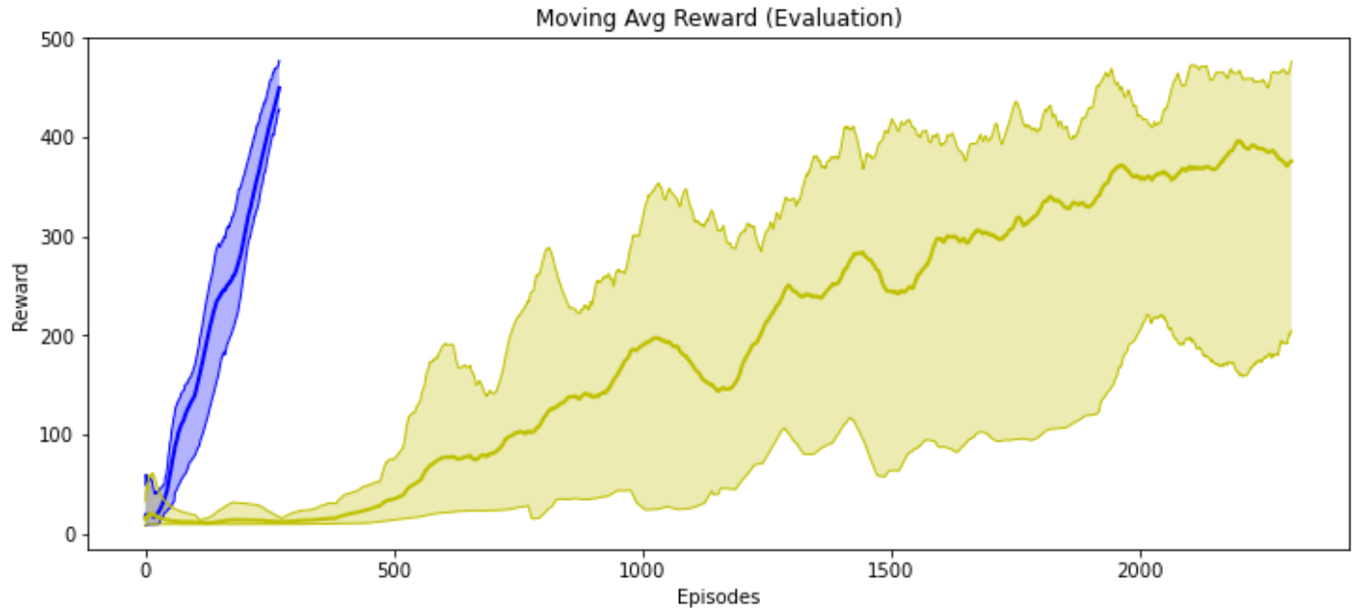
Comparison (1)
See “comparison.ipynb”
Both pass the cart-pole environment
DQN takes approximately 250 episodes while NFQ takes almost 2,500 episodes
DQN is more sample efficient than NFQ
Notice how NFQ is also noisier than DQN

Slide 14
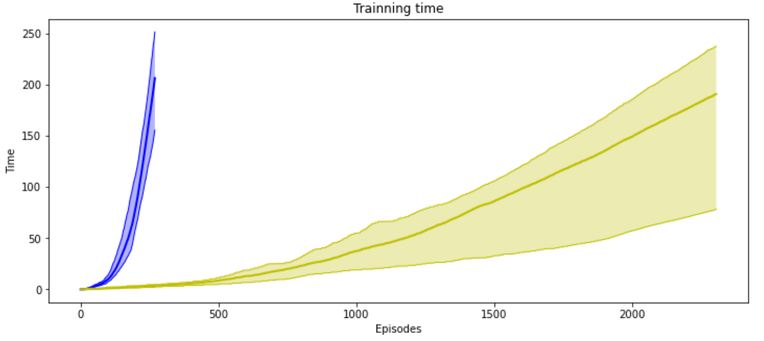
Comparison (2)
However, DQN takes more training time than NFQ to pass the environment.

Slide 15
More advanced approaches (1)
Double DQN (DDQN)
like Q-learning, DQN tends to overestimate
we’re taking the max of estimated values to estimate the max
a way to reduce positive bias is to have two instances of the action-value function
we can perform double learning with the other network we already have: the target network
Dueling DDQN
RL-aware neural network architecture
Prioritized Experience Replay (PER)
Instead of uniformly sampling reply memory, we draw samples that appear to provide the most information to the agent for actually making improvements
Challenges:
sensitive to hyperparameters
combination of bootstrapping, off-policy learning, and function approximators are known conjointly as the deadly triad
it is known to produce divergence

